Slide 1
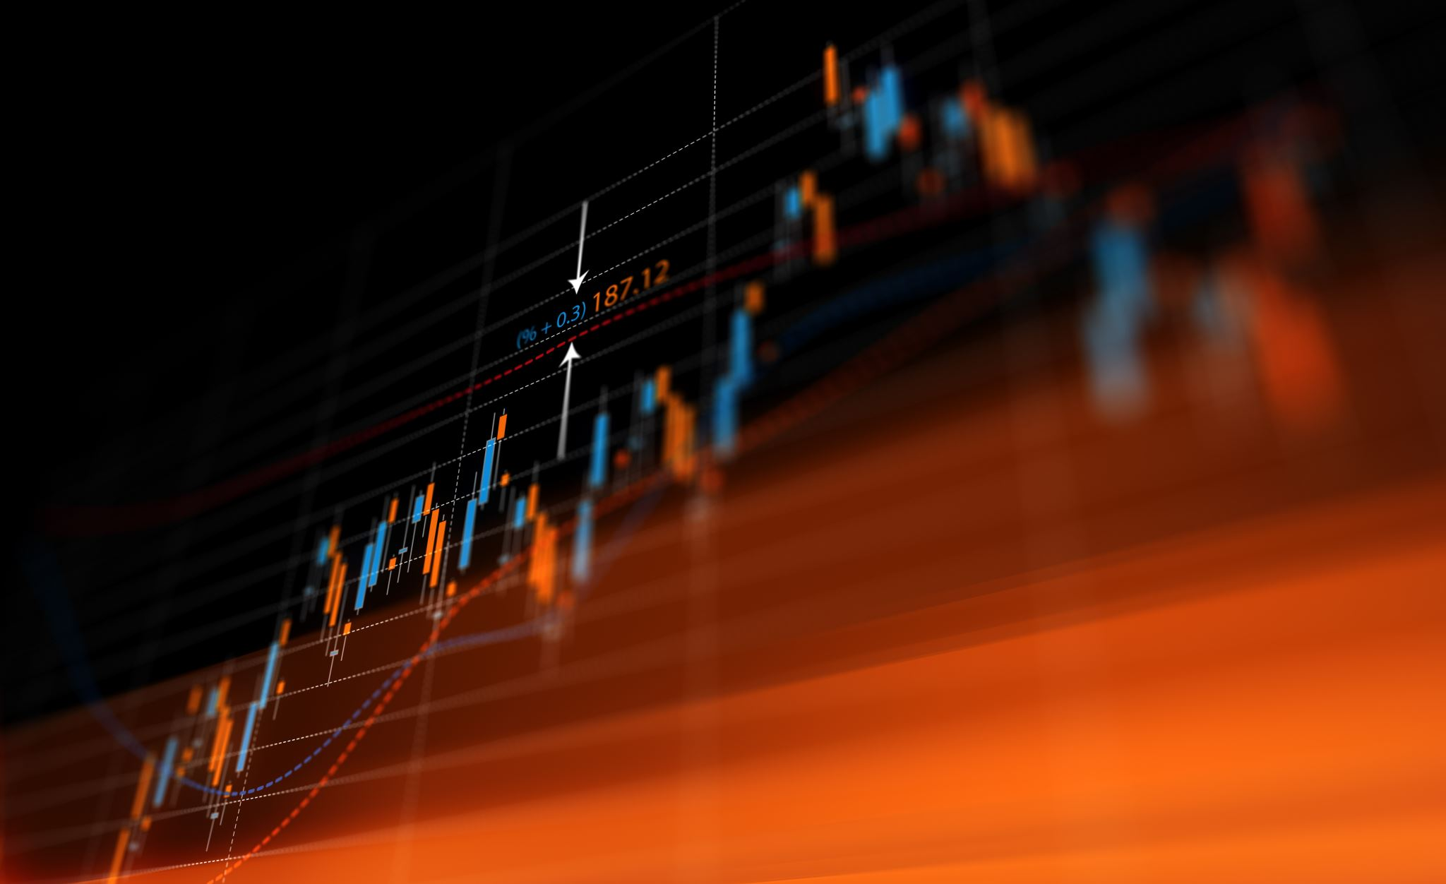
Application of Technical Analysis to Portfolio Management
Sowmi Krishnamurthy CMT
CEO | SK Market Insights Ltd
March 11, 2023
Presentation to Institute for Investment and Business Mgmt (IBIM)

Slide 2
Disclaimer
© Copyright SK Market Insights 2023 protected original work, all rights reserved.
The information provided in this article/document is created by SK Market Insights Ltd and is provided for educational and information purposes only. It is not intended or to be construed as an offer, incentive, advice to subscribe for or underwrite securities solicitation to buy sell or invest or deal in any financial instruments or participate in any particular trading or investment strategy in any jurisdiction,
The markets or financial instruments or such other matters discussed in this report may not be suitable for all and readers must make their own investment decisions using their own independent advisors as they believe necessary and based upon their own specific financial situations and investment objectives.
For permission to use any of the content of this research material please contact info@skmarketinsights.com

Slide 3

Sowmi Krishnamurthy
Sowmi Krishnamurthy is a Chartered Market Technician (CMT) and a member of the CMT Association, N.Y., U.S.A. After a successful career with Mobil/ExxonMobil in a variety of trading and management roles across U. S. A., Asia Pacific and Europe, he decided to further his knowledge and understanding of technical analysis, leveraging on his prior experience. He has a Ph. D in Chem. Engg. and an M. B. A. in Finance. He currently provides education, research and consulting services in energy and finance through SK Market Insights Ltd (www.skmarketinsights.com), a U.K. limited company and can be contacted via info@skmarketinsights.com.

Slide 4
Objectives of Portfolio Management
Achieve a desired investment goal
Enhance Alpha
  Excess returns over a benchmark
Minimize drawdowns
“Portfolios comprised of investments with good growth opportunities, solid financial health, attractive intrinsic value and superior competitive positioning tend to outperform over the long run” *
* Robert A Weigand, Chapter 19, CMT III handbook

Slide 5
Technical Analysis tools* for portfolio management
Dow Theory
Moving Averages
Breadth Indicators
Fibonacci ratios
Point and Figure charting
Elliot Wave Analysis
* Not all inclusive
Candlesticks
Bollinger bands
Relative strength measurements
Momentum investing
Seasonal cycles
Ichimoku Cloud
Machine learning

Slide 6
Applicable across Asset Classes and Geographies
Bonds
Stocks
Real Estate
Commodities
Private Equity
Currencies
U. S. Treasuries
Non U. S.
US Corporate
U. S.
Non U. S.
U. S. only
USD
AUD/JPY
Other
U. S.
Developed
Emerging
Energy
Agriculture
Base metals
Precious metals

Slide 7
Dow Theory
Dow theory (Charles Dow | 1851 – 1902) states that price advances are marked by higher highs and higher lows
A change in trend occurs when a pattern of lower highs and lower lows are formed
Uptrend resumes when higher highs and higher lows reappear
Example shows Microsoft (MSFT) in both an uptrend as well as a downtrend

Slide 8
Moving Averages
Identify trends based on look back periods
Close of day prices commonly used for calculations
Simple moving average (SMAs) most frequent calculation method - gives equal weight to all data in lookback period
20, 50 and 200 day look back periods widely used for short, medium and long term
Exponential moving averages are an alternative calculation method - give higher weightage to more recent prices
Simple rules to follow;
  Moving averages serve as a proxy for trend lines
  Prices above all three up trending moving averages imply a strong uptrend and vice versa
  Moving average cross overs imply changing trend

Slide 9
Sample charts of moving averages

Slide 10
Relative strength as a selection tool
Applicable to asset classes as well as individual investment selection
Calculated as asset price compared to a reference price
Rising trend indicates asset outperforming reference and vice-versa
Healthcare serves as a safe-haven in a bear market. Dividends a plus
An example chart shows Merck (MRK) in an uptrend. Relative outperformance vs Johnson & Johnson as a reference

Slide 11
Fibonacci ratios
Provide key retracements levels
  38.2% | 50% | 61.8% are key levels
Strong psychological importance in herd behavior
Investors more likely to take action at these price points
Confluence of indicators add weightage to the observation
Chart shows US 10 yr Treasury yield holding support at the 50% retracement
  Informs us of direction of the trend

Slide 12
Volatility and Bollinger Bands
Bollinger bands measure volatility of prices over a chosen period
Volatility measured by standard deviation is shown as a blue envelope in chart alongside [20 period, 2 SD]
Charts below price shows width of 2SD bands and relative location of price in the band
Volatility is mean reverting. Low volatility begets high volatility and vice versa
Low volatility is conducive for sustained market rallies

Slide 13
US Stock market and Economic Cycles
Stock markets peak (red) around six months ahead of economic cycles (green)
Late in an economic cycle consumers gravitate to essentials vs luxuries
As growth becomes scarce investors hunt for dividend yield as a shelter
Understanding cycles enables sector rotation in portfolios
Comm services
Real estate
Currently somewhere here

Slide 14
Case Study
SPDR Gold shares
Application of time frames and Inter market analysis

Slide 15
Monthly chart of SPDR GOLD shares
Monthly chart shows a series of higher highs and higher lows from 2005 to present
Correction in uptrend between 2012 and 2016
Uptrend resumed in 2019 and a higher high made in 2020
Currently trading in a range between $150 - $190
Why has the uptrend stalled?

Slide 16
Weekly chart of SPDR Gold shares
More detailed view of rally from 2019
Correction stopped at the Fibonacci 50% retracement
Uptrend has resumed but unable to clear prior high at $185
What is holding Gold back?

Slide 17
Daily chart of SPDR Gold shares
Shows further sideways motion
Gold inversely correlated to the US dollar(USD)
Chart below Gold price shows a steady increase in USD until Nov 2022 followed by a correction
The rise in the USD in the early part of the year coincided with the correction in Gold until Nov 2022, followed by a rally when the USD corrected
Why did the USD correct in Nov 2022?

Slide 18
The USD | US 10 yr. Treasury relationship
The US Federal Reserve started one of the fastest increases in the FED funds rate in 2022 to combat inflation
As seen from the chart, the 10 year US Treasury yields rose from 1.4% at the beginning of 2022 to 4.3% in November, resulting in a strong dollar
Interest rates subsequently corrected in the November 2022 through January 2023 resulting in a corresponding weakness in the USD
Higher highs in Gold may have to await a weaker USD which in turn will depend on a further correction in the US interest rates

Slide 19
Summarising…
Technical analysis tools can be applied to build a strong portfolio
Choose the strongest performing investment, in the strongest sector and in the strongest asset class
Identify trend reversals to capture profits and minimize drawdown
Keep volatility on your side
Manage time in market.
In bear markets, cash is King!

Slide 20
Thank You!
Questions?
Contact
  info@skmarketinsights.com

Slide 21
References
CMT Level III “The integration of Technical Analysis”, Readings selected by the Market Technicians Association, Wiley, 2017
Bollinger on Bollinger Bands, John Bollinger, McGraw Hill, 2002
Dual Momentum Investing, Gary Antonacci, McGraw Hill, 2015
The Candlestick Course, Steve Nison, Wiley, 2003

